Slide 1
Enhancing Cloud Efficiency: A Generative AI and Deep Learning Analysis of Performance Metrics
Submitted by Harish Prabhakar
Masters of science in Data science
(Final Thesis) Master of Science in Data Science Liverpool John Moore's University
Supervisor: Dr Jayakrishna Gutha
Submitted: August 2025

Slide 2
Agenda
Background of the Study
Problem Statement
Objectives and Scope
Research Methodology
Model Architectures (LSTM, Transformer, CNN-LSTM)
Implementation & Visualization
Results & Evaluation
Key Contributions
Conclusion

Slide 3
Background of the Study
Cloud adoption > 94% globally
Resource over-provisioning leads to 35-40% cost waste
Importance of elasticity, cost-efficiency, and SLA adherence
Deep learning as a driver for predictive cloud management

Slide 4
Problem Statement
Static provisioning methods lead to: - Over-provisioning (waste)
- Under-provisioning (performance risk)
Need for dynamic, intelligent forecasting
Gap: Lack of integration between predictive modeling and operational dashboards

Slide 5
Objective
Implement LSTM, Transformer, and CNN-LSTM models
01
Forecast future CPU, RAM, and storage demands
02
Build interactive dashboards for cloud operations
03
Improve cost efficiency and infrastructure scaling
04

Slide 6
Scope of Study
Dataset: VM performance data (CPU, RAM, Storage)
Tools: Python (Keras, TensorFlow, PyTorch), Power BI
Focus: Public cloud-based VMs
Excludes: Cybersecurity, physical infra
Target output: Forecast reports, anomaly detection, decision insights

Slide 7
Building Blocks- DL & Gen-AI models
LSTM – Long Short Term Memory
CNN-LSTM (Convolutional Neural Networks)
Transformer Model

Slide 8

LSTM Architecture
LSTM captures sequential dependencies
Forecasting based on past behavior
Trained using CPU, RAM, storage trends
Optimized with Adam, MSE
Output: Predicted resource usage

Slide 9
CNN-LSTM Hybrid
CNN layers: Feature extraction
LSTM layers: Sequential modeling
Robust to anomaly spikes
Best performance in hybrid workloads

Slide 10

Transformer Architecture
Self-attention for long-range dependencies
Positional encoding for sequence order
Strong in high-dimensional time-series data
Accurate in detecting seasonal trends

Slide 11
Research Methodology
Data Collection
Data Processing (cleaning, normalization)
Model Training (LSTM, Transformer, CNN-LSTM)
Evaluation (MAE, RMSE)
Chaos testing for Resilience
Dashboard Visualization (Power BI)

Slide 12
Data Analysis Flow for cloud resource forecasting
RAM VM Performance data(CPU, RAM, Storage)
Data Processing
–Null Value interpolation
- Outlier detection
-Normalization (Minmaxscaler)
Sliding Window Conversion
-Multivariate time series sequence
Model Training
LSTM
CNN-LSTM
Transformer
(Epochs, Batch size,)
Model Evaluation
-MAE, RMSE metrics
-Comparison across models
Chaos-1 Testing
- Inject Random resource spikes
-Validation Prediction stability
Output Generation
- Excel export: Actual vs predicted - Power BI dashboard, Forecast trends

Slide 13
Results and Discussions
LSTM Model
Captured long-term patterns in resource usage, especially effective for CPU trends
Slight underperformance during sudden demand spikes
MAE (CPU): 0.042 | RMSE (Memory): 0.058 | MAPE (Storage): 6.3%
CNN-LSTM Model
Convolutional layers detected workload spikes; LSTM captured sequences
Performed better in predicting RAM & IOPS
MAE (CPU): 0.035 | RMSE (Memory): 0.044 | MAPE (Storage): 5.1%
Transformer Model
Outperformed all models via self-attention & positional encoding
Best at handling seasonal trends and sudden fluctuations
MAE (CPU): 0.031 | RMSE (Memory): 0.041 | MAPE (Storage): 4.7%
Visualization Highlights (Power BI)
Line Graphs: Actual vs Forecast
Anomaly Flags: Detected major deviations
Slicers: Time-based filtering
Heatmaps: Identified high-usage periods

Slide 14
Implementation and Dashboard
Forecasts exported to Excel
Power BI dashboards:
CPU, RAM, Storage trends
KPIs
Monthly/Yearly slicers
Actual vs. Forecast views

Slide 15
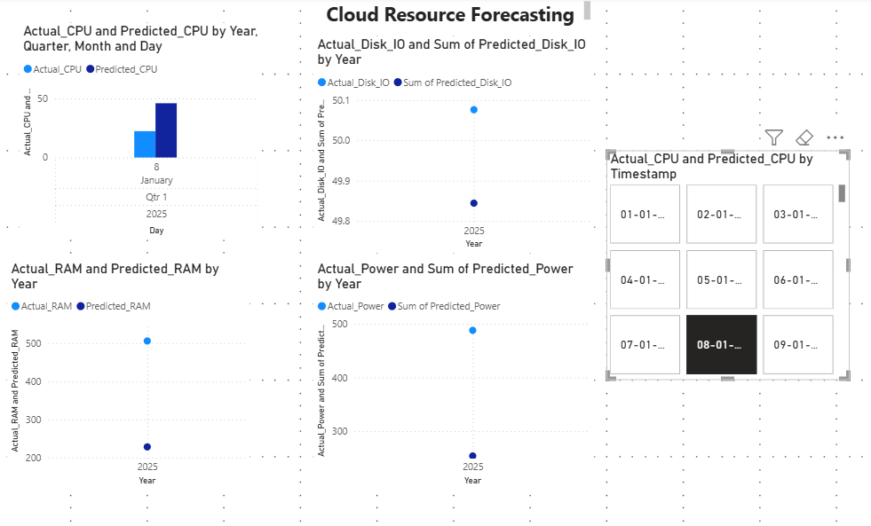
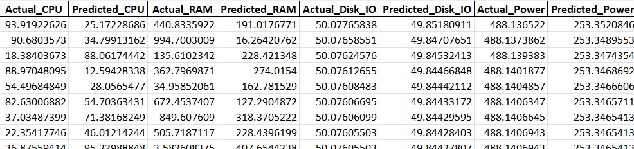
Sample Output- Power BI dashboard & MS Excel

Slide 16
Chaos-1 Testing
Simulates resource fluctuation
Evaluates model robustness
Model stability during peak/unpredictable loads
Ensures reliability in real-world conditions

Slide 17
Evaluation Metrics
Mean Absolute Error (MAE)
Root Mean Square Error (RMSE)
Lower error in CNN-LSTM models
Exportable performance reports

Slide 18
Key Contributions
Hybrid models for accurate forecasting
Real-time Power BI dashboard
Operational insights for cloud managers
Scalable framework for future use

Slide 19
Conclusion
Deep learning improves resource forecasting
Integration into dashboards enhances visibility
Enables cost savings, SLA adherence
Foundation for sustainable cloud operations

Slide 20
Thank You!
Questions?

